Slide 1



SRM INSTITUTE OF SCIENCE AND TECHNOLOGY
SCHOOL OF COMPUTING
DEPARTMENT OF COMPUTING TECHNOLOGIES
21CSP302L - MINOR PROJECT
Edge Preserving Enhancement of Spinal Anatomy in Low-Field MRI
Guide name: Dr.E. Poovammal
Designation: Professor
Department: C.Tech
Batch ID: B929
Student 1 Reg. No: RA2311003011460
Student 1 Name: T Barathkalyan
Student 2 Reg. No: RA2311003011470
Student 2 Name: Sarukeshwar S

Slide 2
Problem Statement
Low-field MRI scanners (0.1–0.5 T) produce images with much lower quality, about 3–6 times noisier than standard 1.5 T scans, which in the lumbar spine can blur disc edges, obscure nerve compression, and reduce fat–fluid contrast, all critical for diagnosis. Current solutions often rely on AI super-resolution models, but these require large paired datasets, high-end GPUs, and produce black-box results, making them challenging for smaller clinics and regulatory approval. Our approach takes a different path: we simulate low-field images from high-field scans using physics-based rules and then restore them step by step with a fully classical, interpretable pipeline that runs on a standard computer and works consistently across scanners.

Slide 3
Objectives
• To simulate realistic low-field lumbar spine MRI from high-field data by modeling reduced spatial resolution and noise characteristics observed in low-field systems.
• To design and develop a structured enhancement framework to improve the visual and structural quality of low-field MRI images.
• To apply preprocessing and image quality optimization techniques to enhance contrast, clarity, and anatomical interpretability while preserving structural integrity.
• To quantitatively evaluate the enhancement performance using similarity and signal-based metrics with respect to the original high-field reference image.
• To establish a computationally efficient and fully interpretable classical enhancement baseline that approaches high-field perceptual quality without relying on deep learning methods.

Slide 4
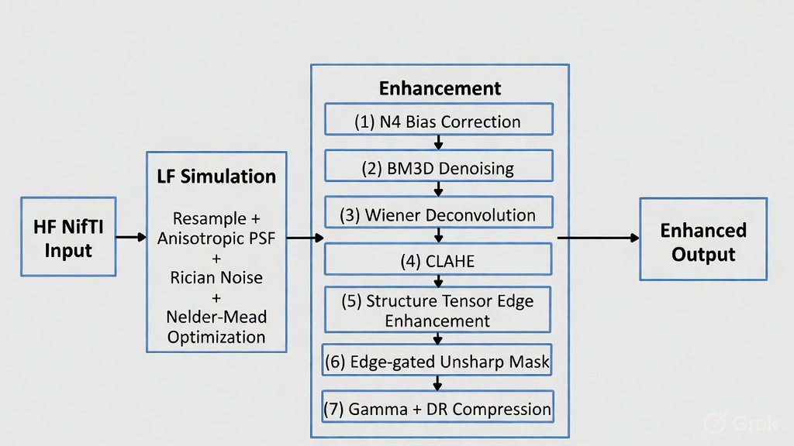
Proposed Methodology

Slide 5
Proposed Methodology (cont.)
1. N4 Bias Correction Removes slow spatial intensity bias in MRI (applied conditionally if significant).
2. BM3D Denoising Reduces noise while strongly preserving edges and fine structural details.
3. Wiener Deconvolution Sharpens image by reversing anisotropic blur with minimal ringing artifacts.
4. CLAHE Boosts local contrast adaptively without excessively amplifying background noise.
5. Structure Tensor Edge Enhancement Directionally sharpens tissue boundaries along principal orientation with low gain.
6. Edge-gated Unsharp Mask Mildly sharpens only strong edges while protecting smooth uniform regions.
7. Gamma + Dynamic Range Compression Adjusts brightness perceptually and clips extremes for improved display contrast.

Slide 6
Expected Outcome
Product / Research Output
The proposed research presents an interpretable image enhancement framework for low-field lumbar spine MRI. The system simulates realistic low-field characteristics from high-field data and applies a structured classical enhancement pipeline to improve contrast, clarity, and structural visibility without using deep learning models.
Outputs of the System
The framework emphasizes computational efficiency, reproducibility, and practical clinical usability.
Outputs of the System
Simulated low-field lumbar MRI from high-field reference images
Enhanced low-field MRI with improved contrast and edge clarity
Quantitative evaluation using SSIM and PSNR metrics
Noise-reduced and structure-preserved diagnostic outputs
Interpretable classical enhancement baseline (no GPU required)

Slide 7
Expected Outcome (cont.)
SDG Mapping
This research aligns with the following United Nations Sustainable Development Goals:
• SDG 3 – Good Health and Well-Being
Supports improved diagnostic accessibility by enhancing low-field MRI quality in resource-limited and rural healthcare settings.
• SDG 9 – Industry, Innovation, and Infrastructure
Promotes innovation in cost-effective medical imaging technologies through computationally efficient enhancement methods.
• SDG 10 – Reduced Inequalities
Contributes toward reducing disparities in advanced medical imaging access by improving the usability of low-field MRI systems.

Slide 8
Conclusion
The proposed system presents a computationally efficient classical framework for enhancing low-field lumbar spine MRI images. Realistic low-field characteristics are first simulated from high-field data, and a structured multi-stage enhancement process is applied to improve contrast, reduce noise, and strengthen structural clarity while preserving anatomical details.
By avoiding deep learning models and heavy GPU requirements, the framework ensures interpretability, reproducibility, and practical deployability. Quantitative evaluation demonstrates that classical methods can significantly improve low-field image quality and move it closer to high-field standards, establishing a reliable and efficient baseline for low-field MRI enhancement.

